Slide 1
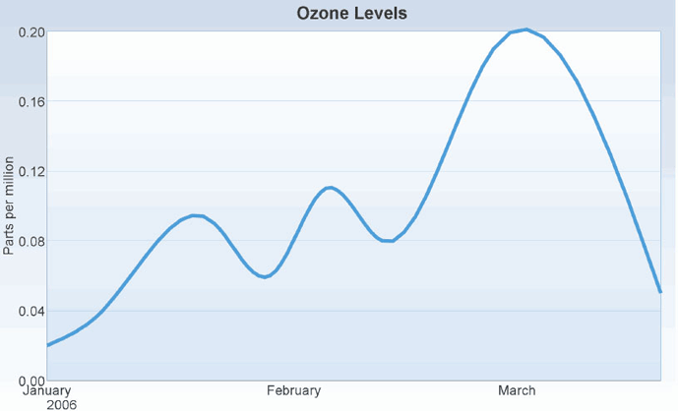
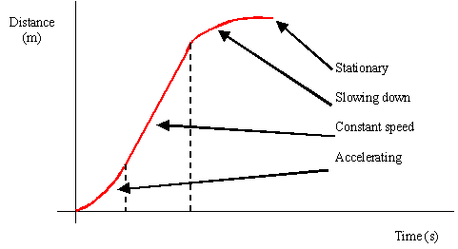
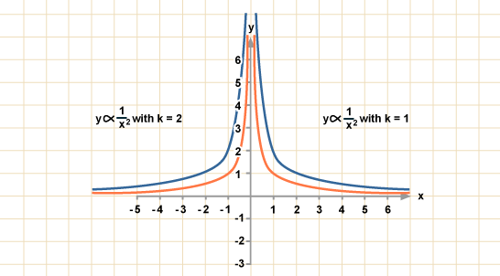
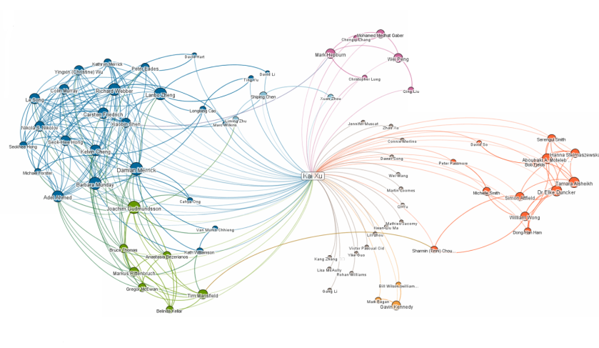
Gradients on a
curved graph

Slide 2
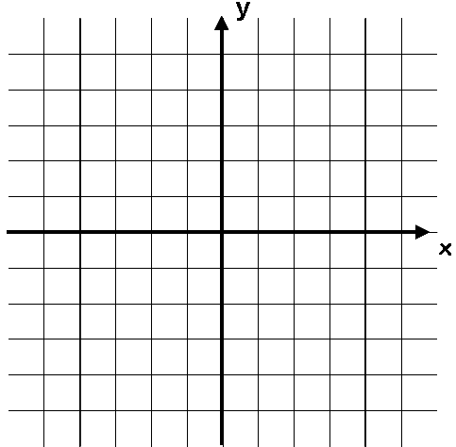
Starter
Question 1: Match up the equation with its graph
Question 2: Write the gradients of each of these lines
y = x²
y = -x² + 2
y = -x² - 2
y = x² - 2
y = x² + 2
y = -x²
5
5
a)
b)
-5
5
-5
5
-5
-5
c)
d)
5
10
e)
f)
-5
5
-5
5
-5
-10

Slide 3
Starter
Question 1: Match up the equation with its graph
Question 2: Write the gradients of each of these lines
y = x²
y = -x² + 2
y = -x² - 2
y = x² - 2
y = x² + 2
y = -x²
5
1
5
4
1
a)
b)
2
-5
5
-5
5
-5
-5
c)
d)
Gradient = 2
Gradient = -1
5
10
1
4
e)
f)
-5
5
-5
2
5
8
-5
-10
Gradient = ¹/₄
Gradient = -4

Slide 4
Gradients on a curved graph
You have already seen how to calculate the gradient of a linear graph by dividing the change in y by the change in x
Also known as ‘rise over run’
What if you were asked to calculate the gradient of this line?
The problem on a curved line is that the gradient is different depending on where on the line you are…
On the left side, the gradient will be negative
On the right side, the gradient will be positive
However, we can use a technique to estimate the gradient, using what you already know…
Line is downward sloping so the gradient is negative
Line is upward sloping so the gradient is positive

Slide 5



Gradients on a curved graph
Draw a straight line that just touches the curve where x = 2
This line is known as a tangent to the curve
You can calculate the gradient of it like on a straight line graph
The value will be an estimate of the gradient of the curve at the given point
Estimate the gradient of this line where x = 2
5
2.2
x = 2
2
-5
5
$$Gradient=\frac{rise}{run}$$
$$Gradient=\frac{2.2}{2}$$
-5
$$Gradient=1.1$$

Slide 6
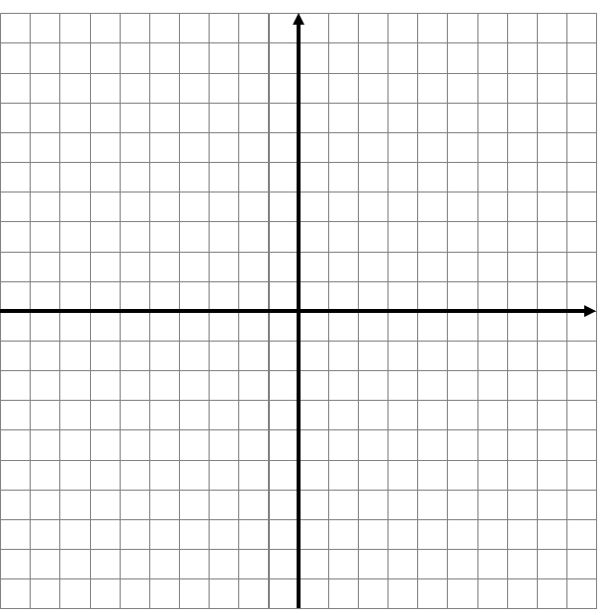
Plenary
f) y = x³ – 4x² + 8x
Find the gradient where x = 2

Slide 7
Summary
We have recapped our knowledge of gradients
We have seen how to estimate the gradient at a given point on a curved line
We have learnt the new word ‘tangent’ and seen what it means mathematically

